Slide 1
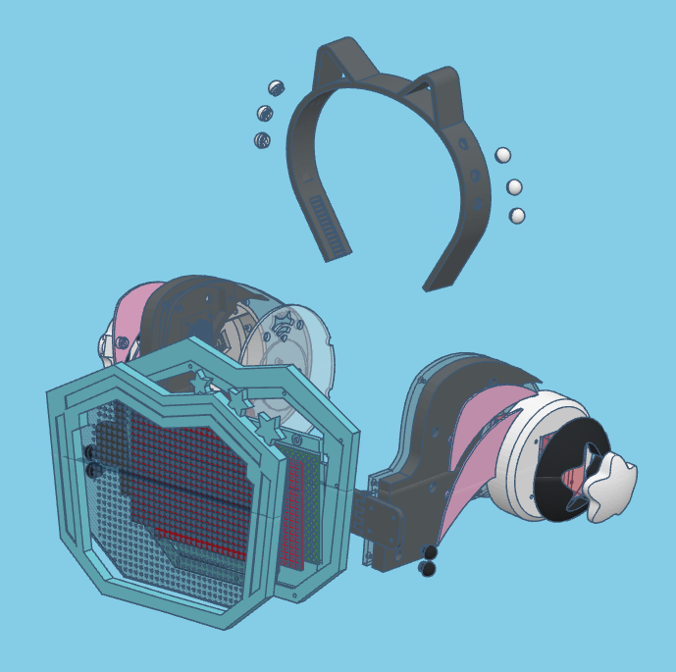
Rina-chan Board V2
Build Tutorial

Slide 2
Tools

Slide 3
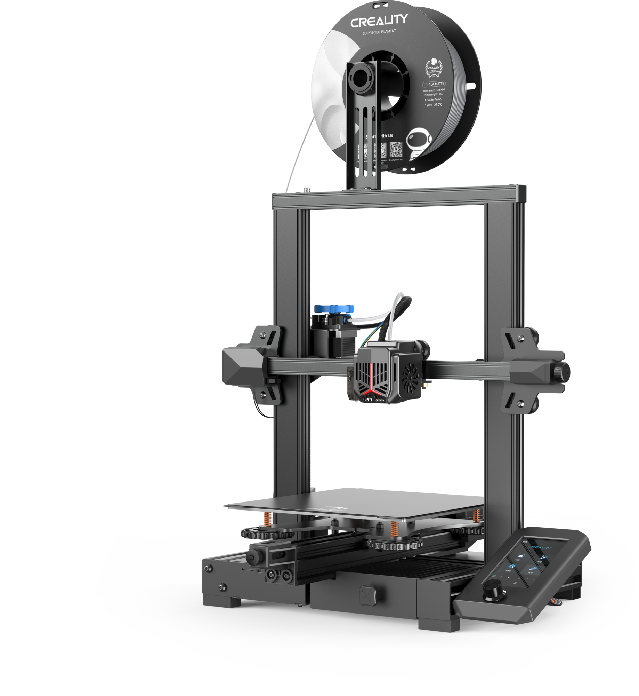

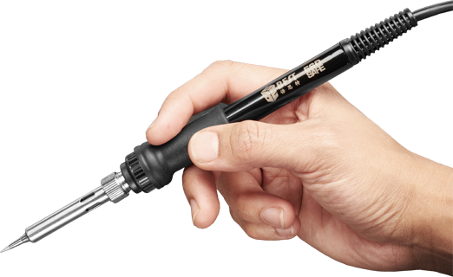
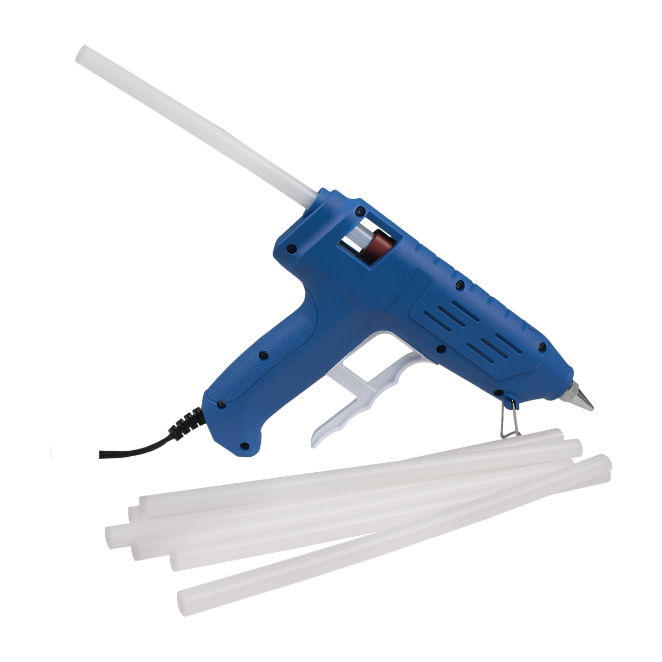
Tools
Computer
3D Printer
Soldering Iron
Optional
Recommended:
Hot Glue Gun
Heat Gun
Brass Heat-Set Insert Tips
Not Recommended:
Heat Set Insert Press/Jig

Slide 4


Computer
Flash the LOLIN C3 MINI (ESP32)
USB Port
Chrome or Chromium-based Browser

Slide 5
3D Printer
Print area “220 x 220” mm or bigger
(I used a Creality Ender 3v2)
Disable skirts/brims when necessary
You may have to edit the firmware to use the entire 235 x 235 mm bed

Slide 6
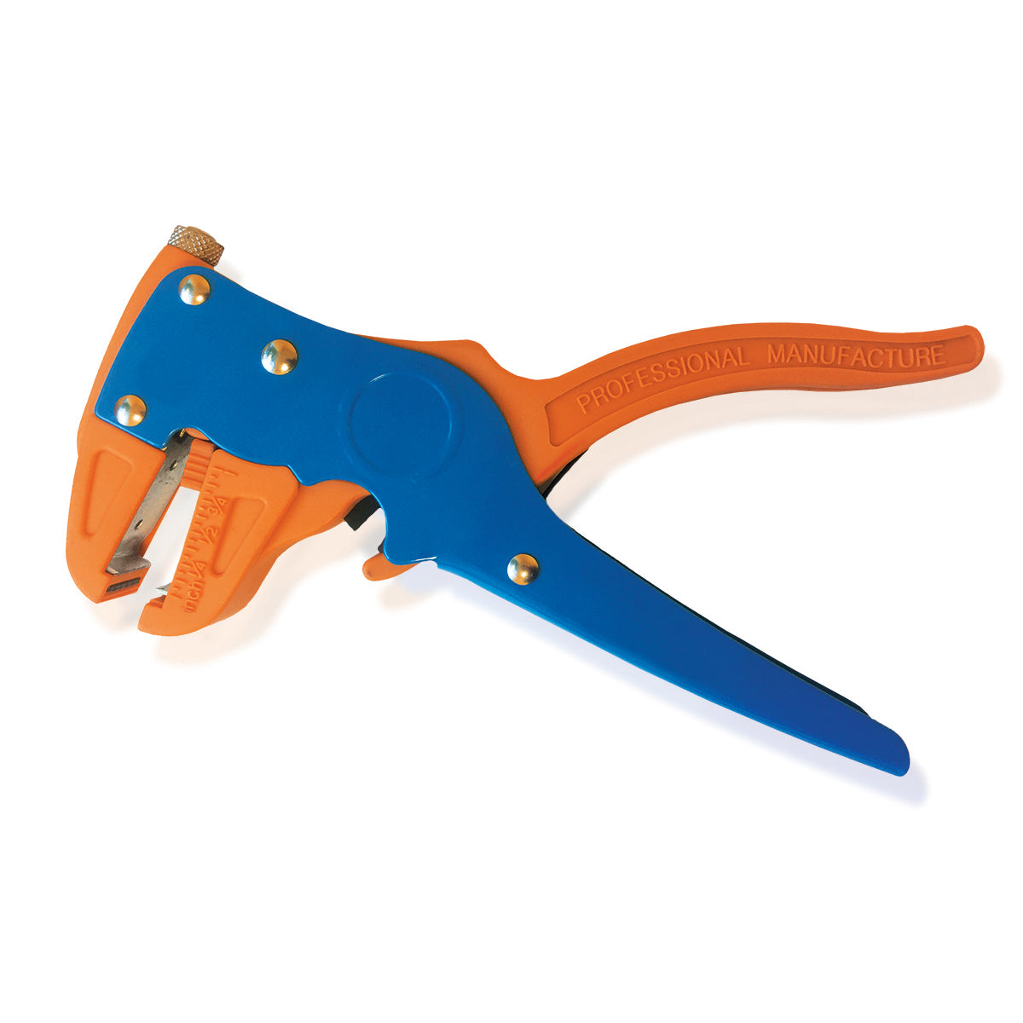
Wire Stripper
Strips wires

Slide 7
Soldering Iron
I can’t teach you how to solder because I’m still bad at it.
Not just for soldering the electronics
Heat-set threaded inserts

Slide 8
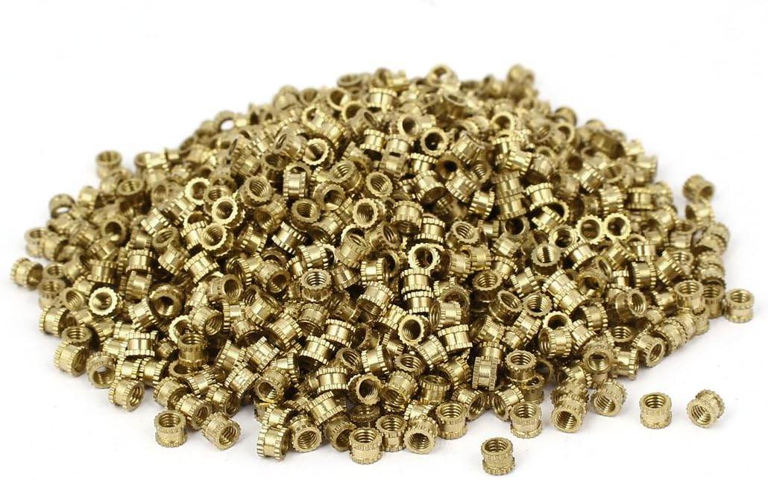
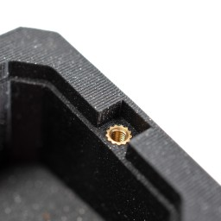
Heat-Set Threaded Inserts
Screw threads
Get inserted into plastic
With heat
Sold in sets of dozens or hundreds
More durable than modeled threads
But most importantly (for me), it’s easier to model a hole than a screw hole

Slide 9
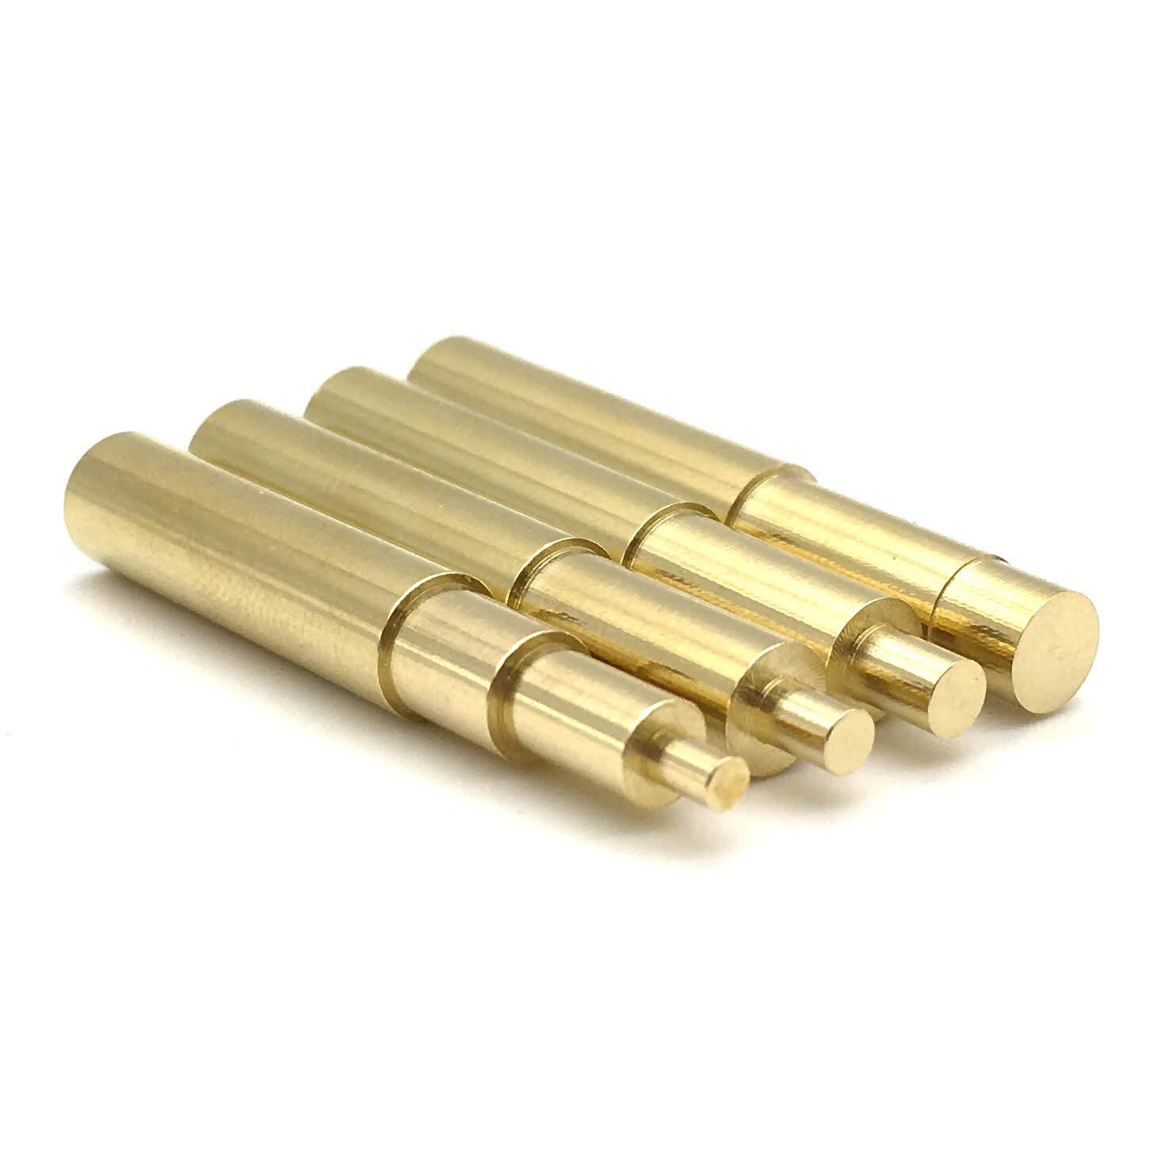
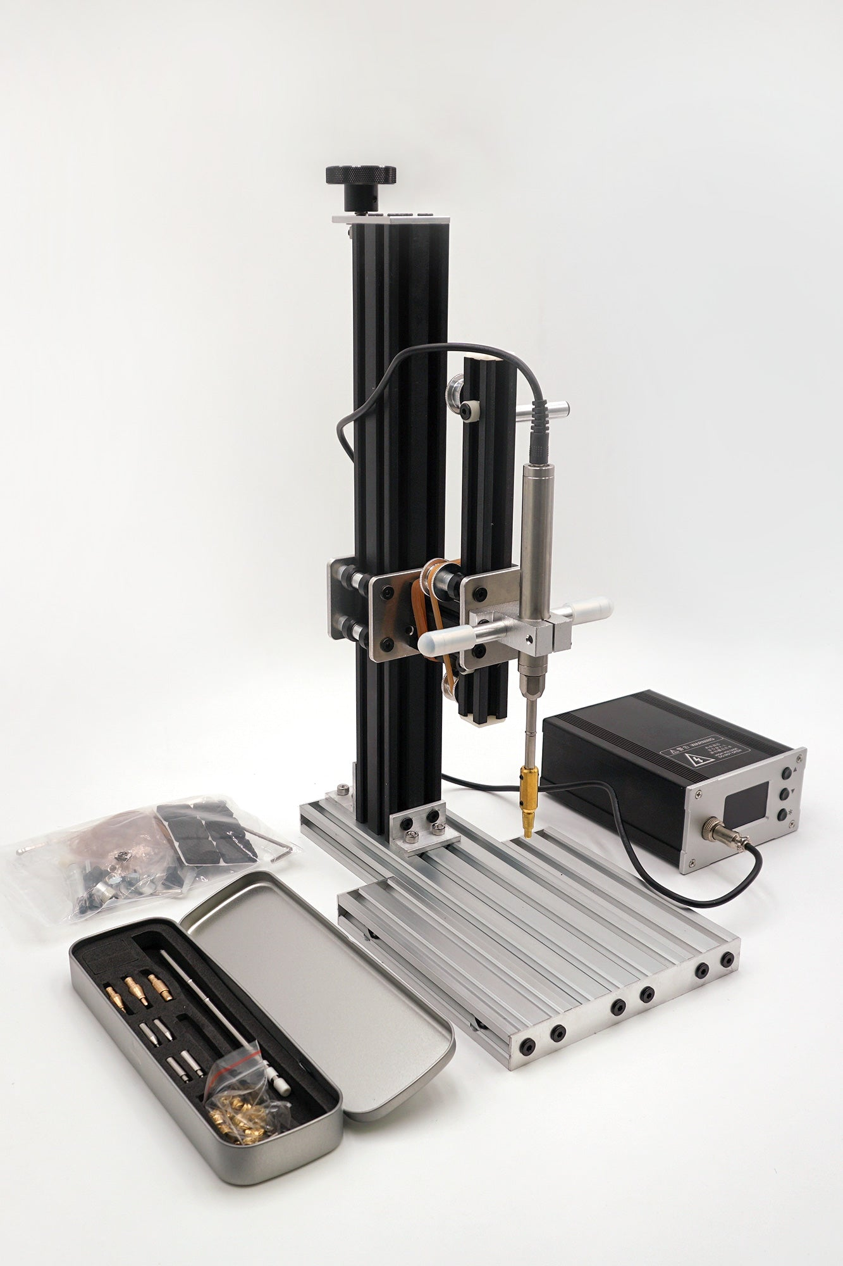
Heat-set Threaded Insert Insertion
Tip: Use a TIP
Specially-designed soldering iron tips
Don’t snag onto inserts
Mostly use M3 size, but M2 is used a few times
Presses and Jigs are costly and not necessary

Slide 10
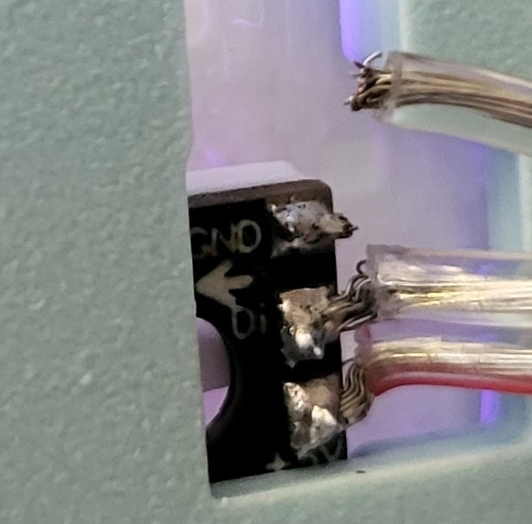
Hot Glue Gun
Prevent strain on solder points
(Learned this the hard way)

Slide 11
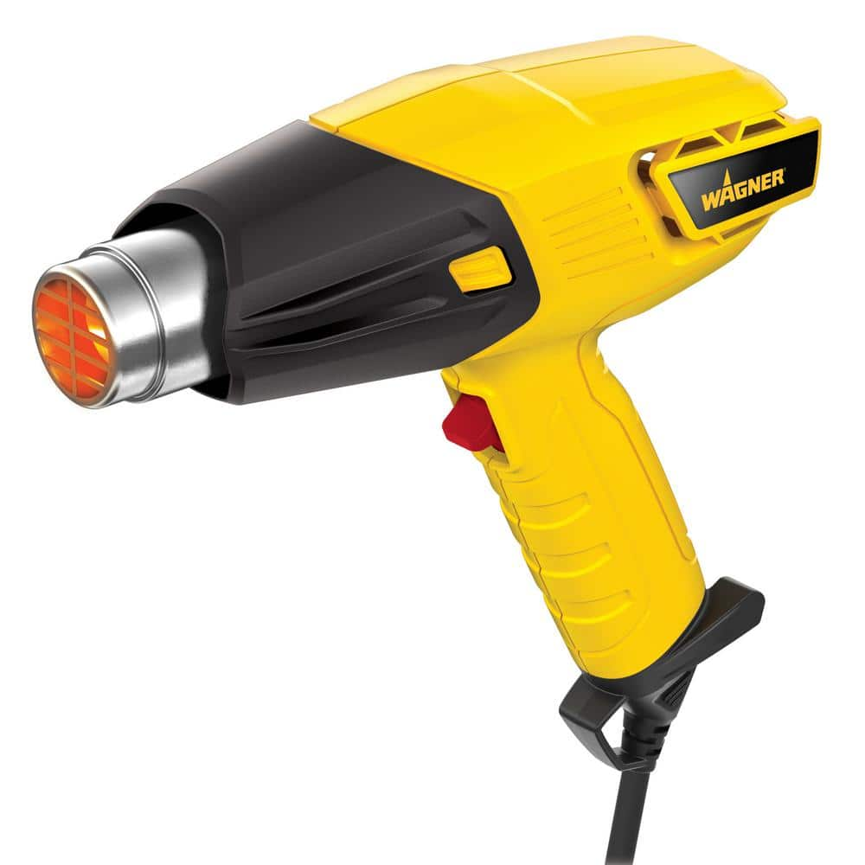
Heat Gun
Resize headband for comfort
Tighten the clip mechanism on earcups
A cheap Harbor Freight gun will work
(EVA foam cosplayers know what’s up)

Slide 12
Materials

Slide 13
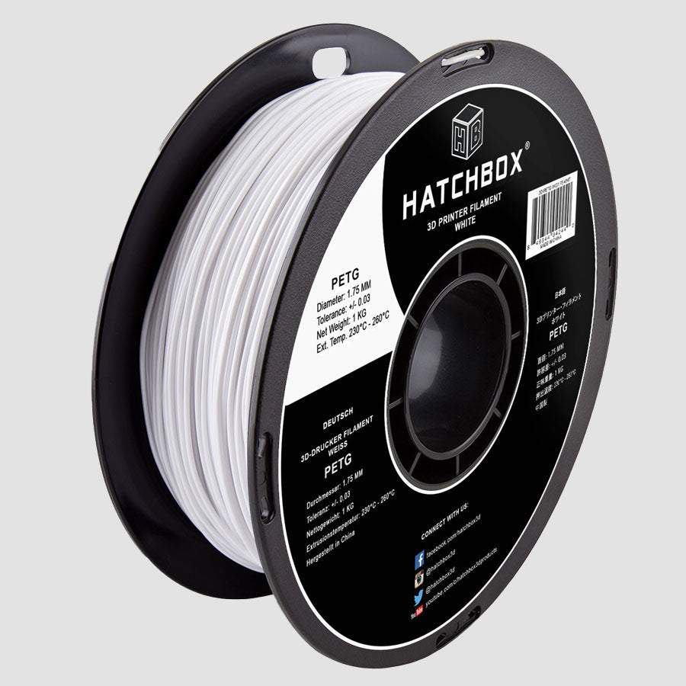
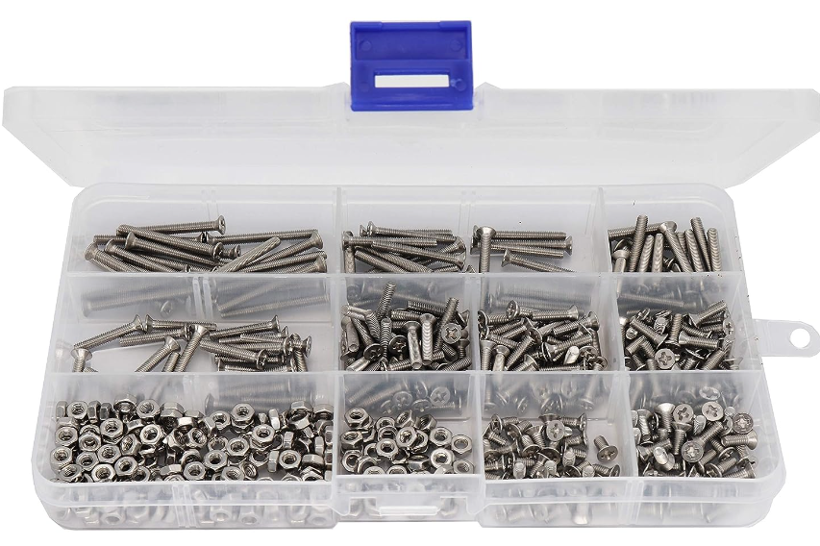
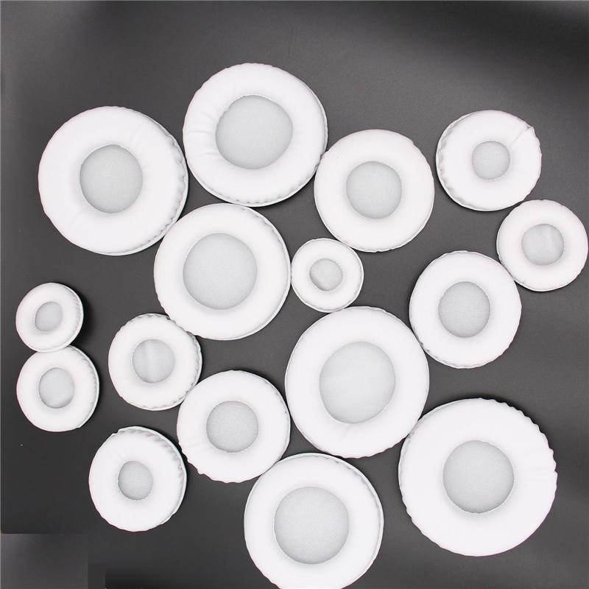
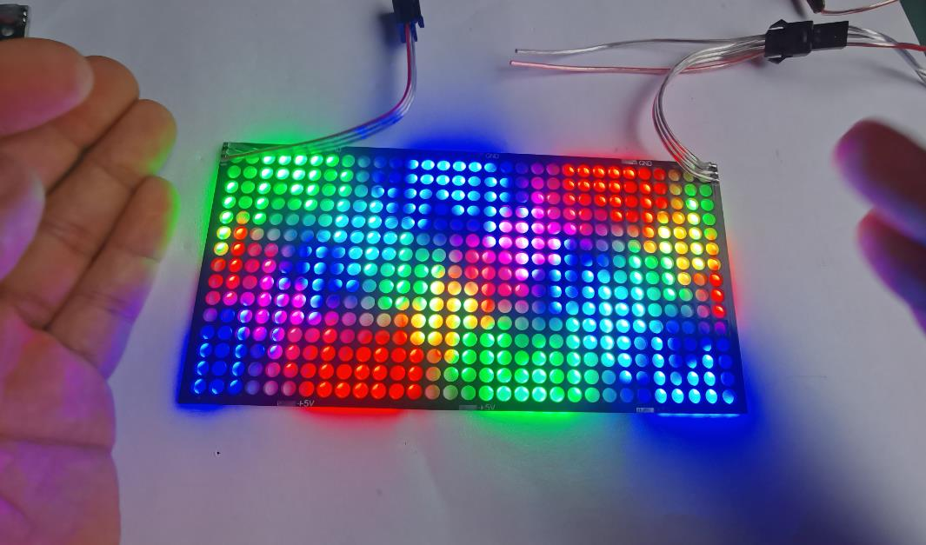
Materials
Filaments
Required: PETG (or ABS)
PLA (for non-structural parts)
Hardware
Countersunk screws, nuts, threaded inserts
Electronics
LED Matrix, microcontroller, battery, charging module, switches, wires, etc.
Etc.
Padding, Glue

Slide 14
Materials: Filaments

Slide 15
Filaments
While PLA can be used for most parts, PETG (or ABS) is REQUIRED for the main “headphone” parts (headband and the ear cups that directly interface with the headband). PLA is too brittle to reliably support the friction fit on these parts.

Slide 16
Filaments for Default Rina-Chan Board (PLA is much easier to print, and Paint if you want)
Must be PETG (or ABS)
Can be PLA (or PETG (or ABS))
BLACK: Headband
WHITE: Ear Cups
BLACK: Ear Domes, Side Spheres
WHITE: Face Plate, Matrix Frame, Foam Holders, Flowers, Headband Dots
SILVER: Inner Sides, Outer Sides, Hinges
CYAN: Front Back, Front Front, Top Accent
PINK: Bottom Accent
RECOMMENDED PETG (or ABS)

Slide 17
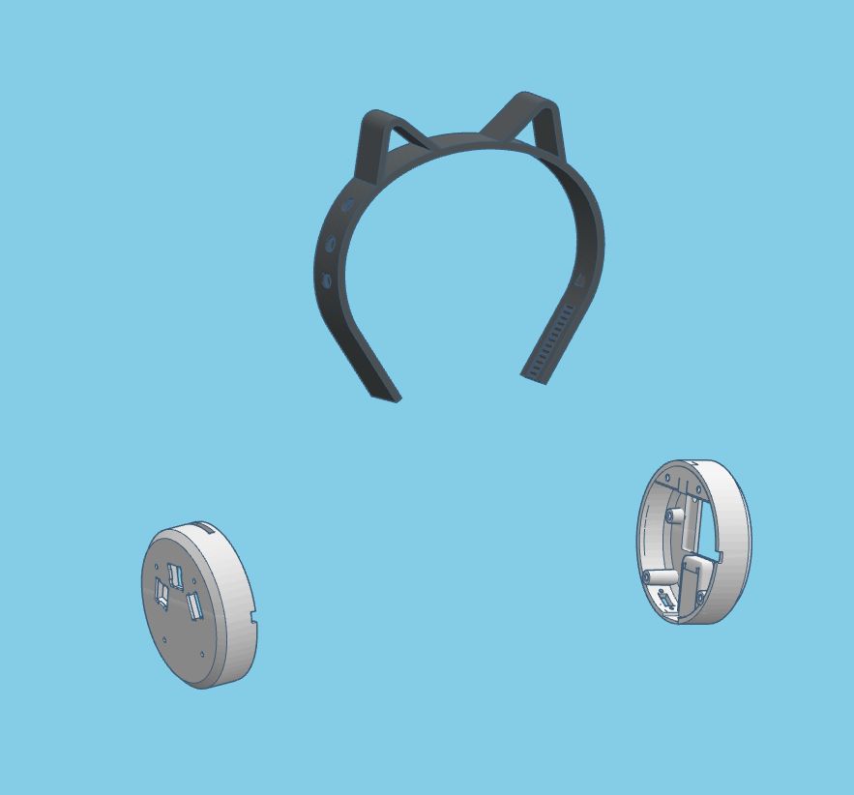
PETG-Required Parts
BLACK: Headband
WHITE: Ear Cups

Slide 18
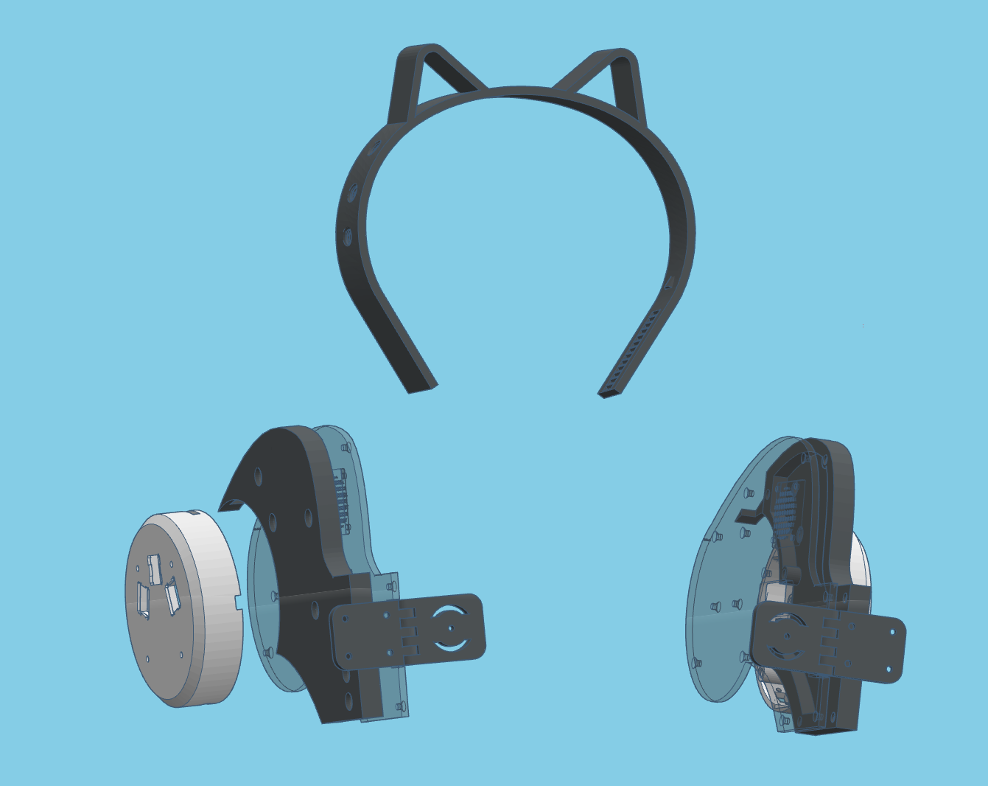
PETG-Required + RecommendeD Parts
BLACK: Headband
WHITE: Ear Cups
SILVER: Inner Sides, Outer Sides, Hinges

Slide 19
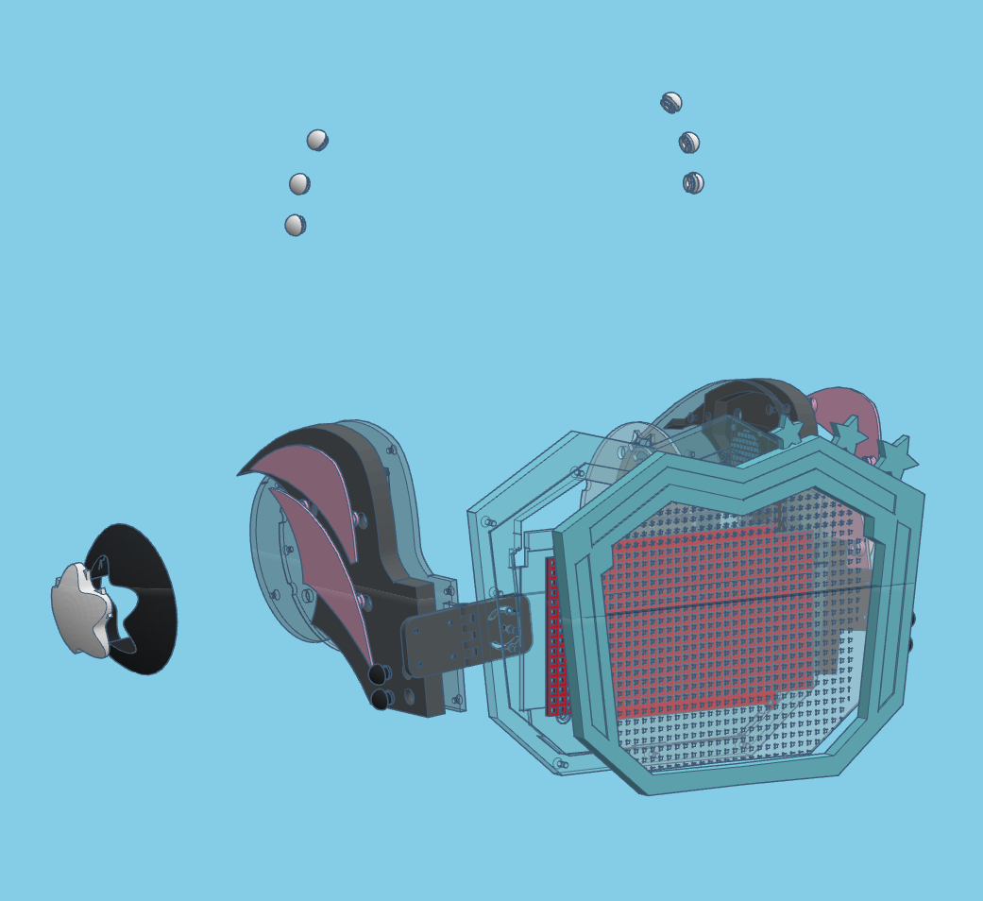
PLA OK Parts
BLACK: Ear Domes, Side Spheres
WHITE: Face Plate, Matrix Frame, Foam Holders, Flowers, Headband Dots
SILVER: Inner Sides, Outer Sides, Hinges
CYAN: Front Back, Front Front, Top Accent
PINK: Bottom Accent

Slide 20
Materials: Hardware

Slide 21

M3 Screws and Nuts
M3 Countersunk Screws (~70 in total)
M3x30mm (x2) for Hinges
M3x6mm or M3x8mm (or maybe even M3x10mm depending on part thickness)
M3 Nuts
Two of deez nuts for bofa the hinges (one nut per hinge)

Slide 22
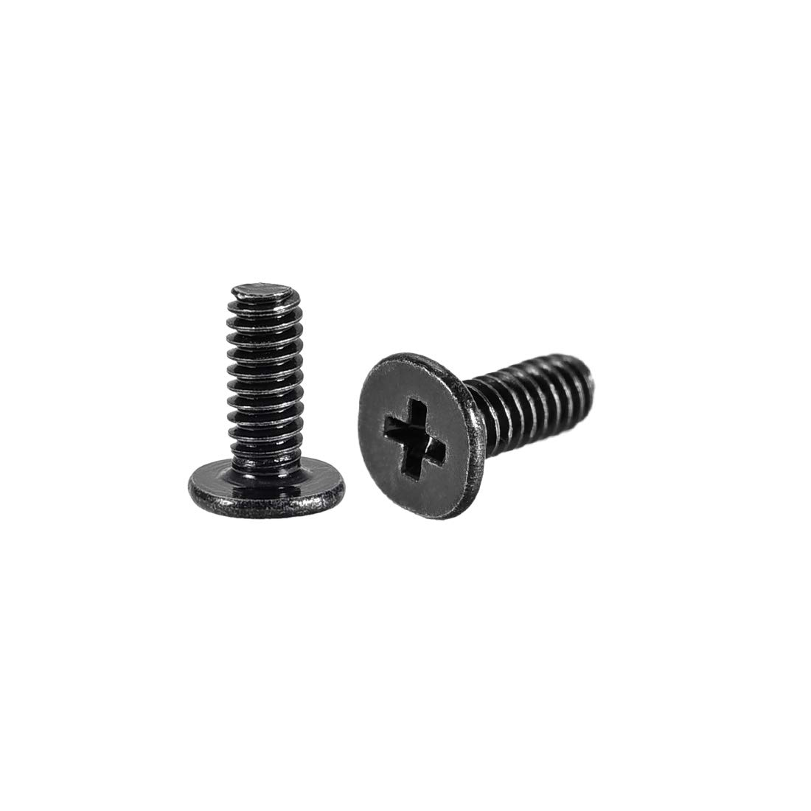
M2 Screws and Nuts
M2x8mm Screws (x2)*
Securing Power Switch
M2x6mm Screws (x2)*
Securing Microcontroller
M2 Nuts (x2)
Power Switch

Slide 23
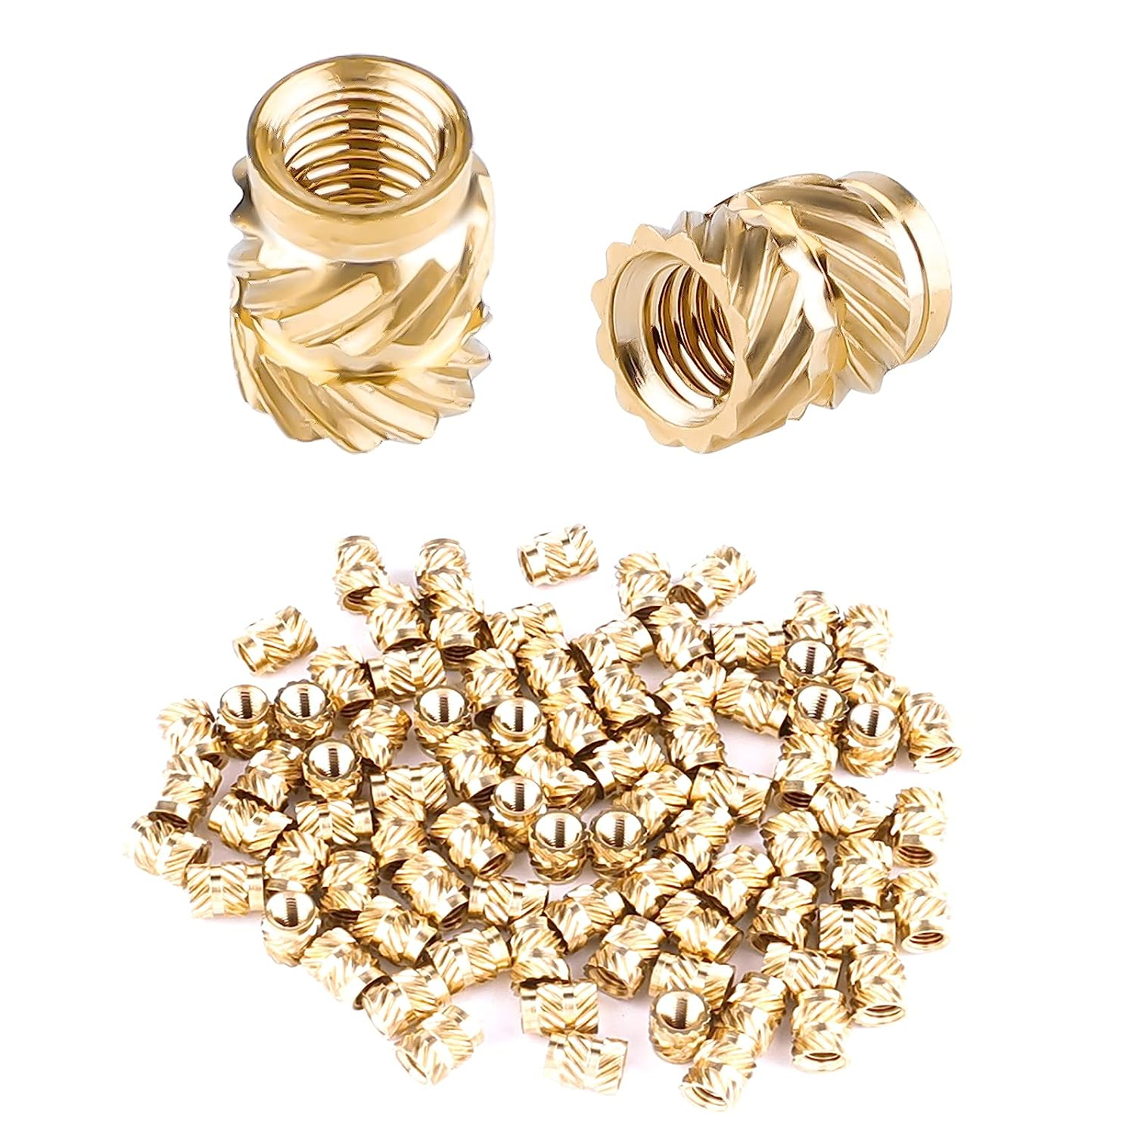
Heat-Set Threaded Inserts (Again)
M2x3mm Inserts (x2)*
For mounting the C3 Mini
*You can use tape instead of inserts and screws since ready access to the C3 Mini’s usb port isn’t that vital.
M3x3mm Inserts (about 70)
For everything else
Avoid fancier, longer ones

Slide 24
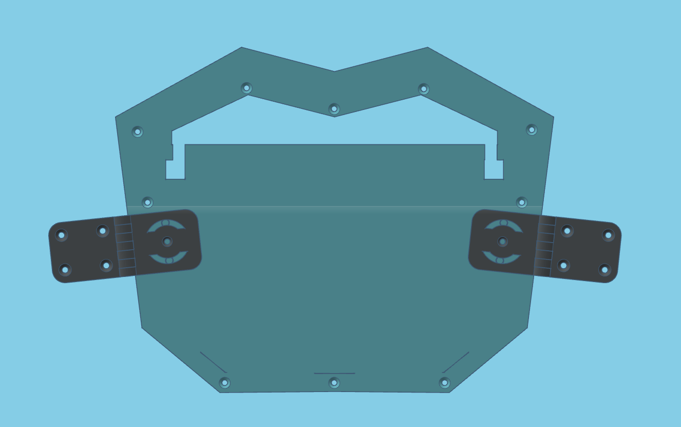
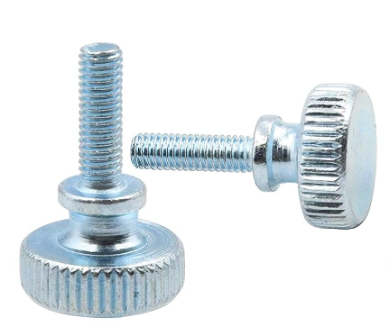
Optional Screws for Attaching the Front
Option 1: M3 Thumb Screws (x2)
Quick, tool-free disassembly

Slide 25
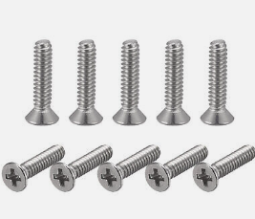
Optional Screws for Attaching the Front
Option 2: M3x10mm (x2-6)
More secure, tighter angle
Cheaper (same M3 screws as before)

Slide 26
Materials: Electronic Parts

Slide 27
16x32 Pixel LED Matrix
My first Rina-Chan Board used a now-unavailable 18x32 matrix
These new 16x32 matrices from AliExpress work just as well after I made a few changes to my code
The code and model are built based off of this specific part (link in description)

Slide 28
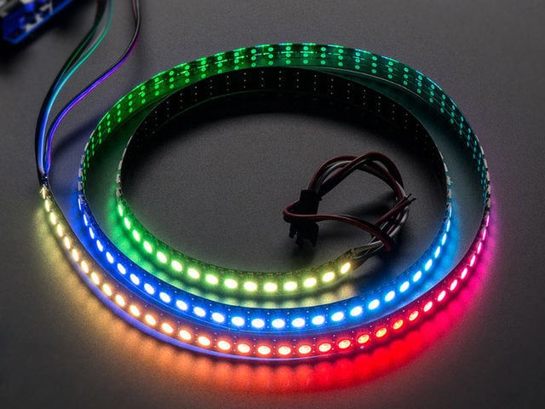
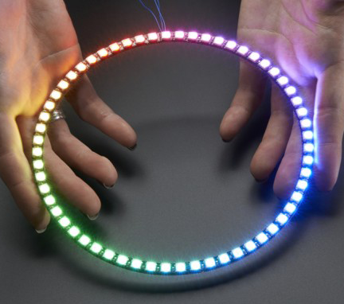
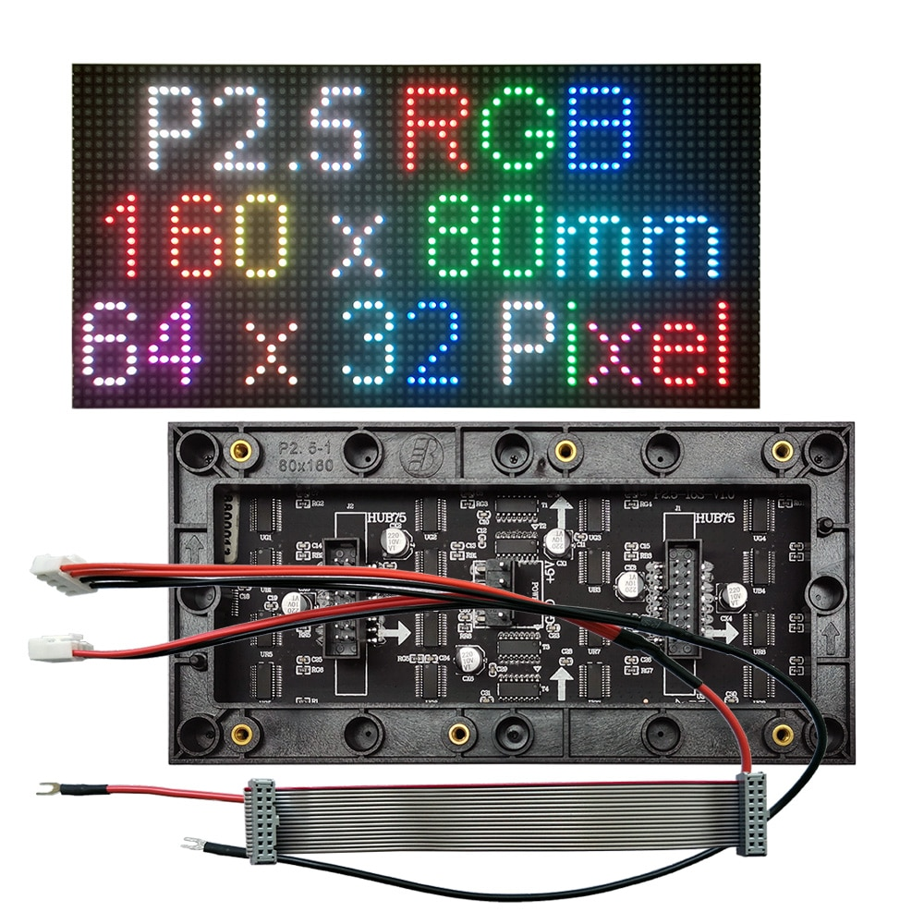
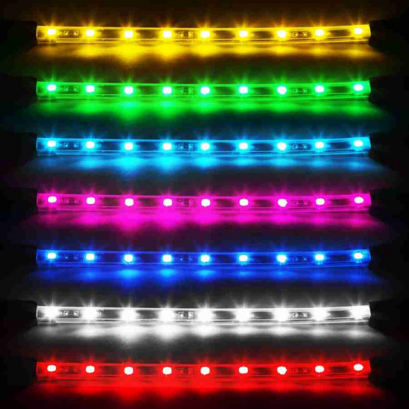
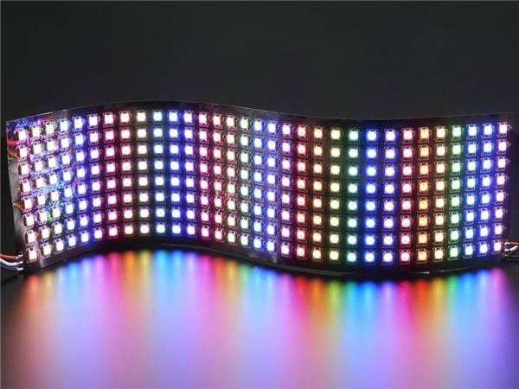
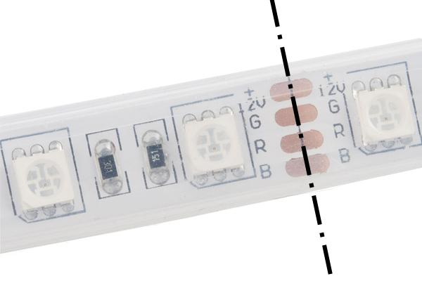
What if I want to try something different?
You MUST use the Arduino IDE to modify parameters of my code.
BAD: HUB75 Matrix or Non-Addressable LEDS
Good: Neopixels (3-pin, Addressable)

Slide 29
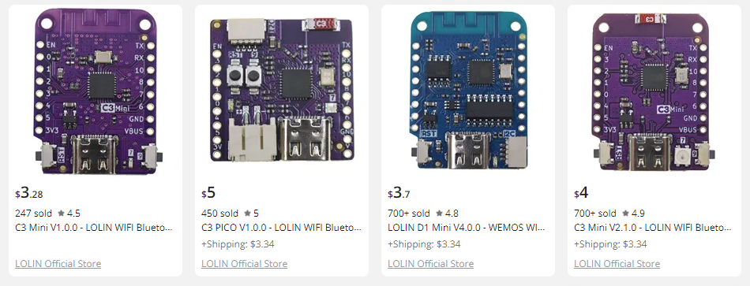
LOLIN C3 MINI (ESP32-C3)
Other boards in the LOLIN “mini” form factor can fit, but this project uses the C3 Mini because it has Bluetooth 5.0 Low Energy (BLE) which allows for phone app control
Save $0.70 by buying the V1. The V2.1.0 just adds an RGB LED we don’t need.

Slide 30
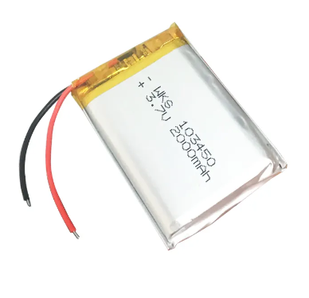
103450 3.7V 2000mAH LiPO Battery
103450 = 10mm thick x 34mm wide x 50mm long
Single battery = 6-7 hours
Two batteries = 12-14 hours
WARNING: Be sure that voltages are equal before connecting batteries together

Slide 31
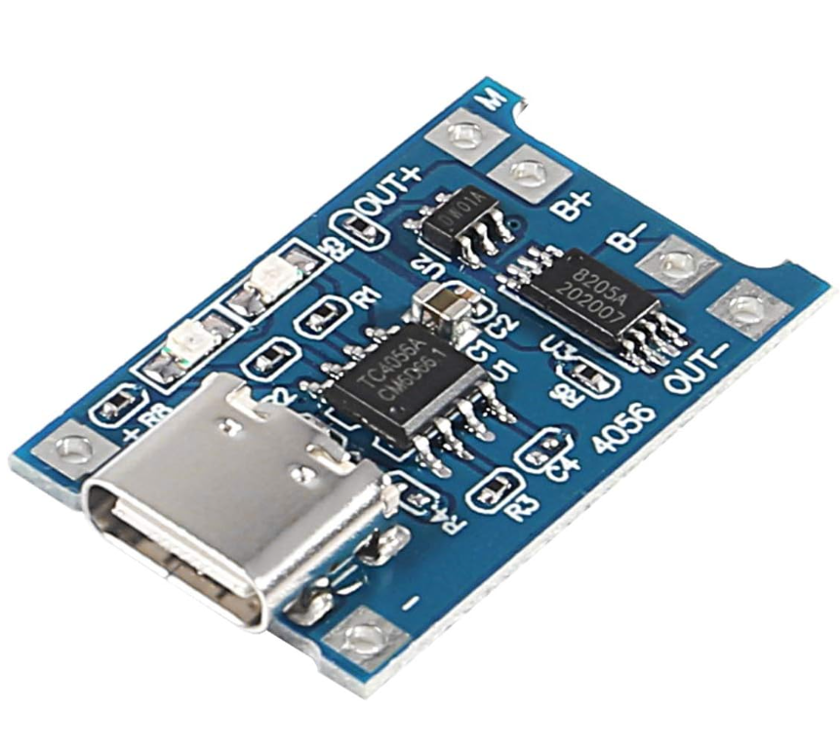
TP4056 Type-C USB Charging Module
Charges the LiPO battery.
Not all TP4056 boards are the same shape/size, so I linked the one I used
May need to trim the front corners
You could use a Micro- or Mini-USB variant if you hate yourself

Slide 32
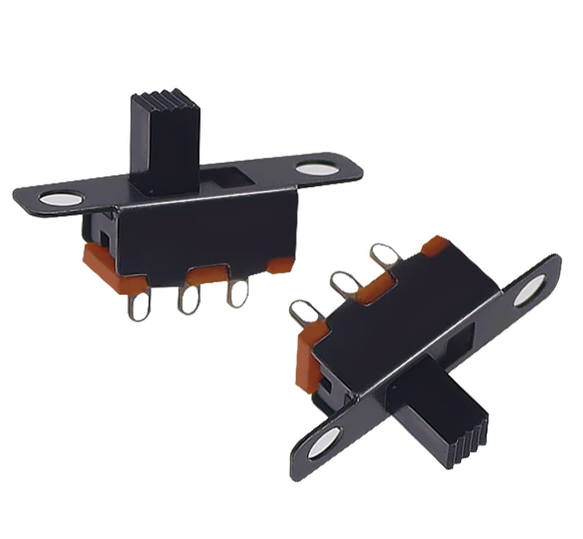
5mm Latching Slide Switch
I just like using these in 3D printed projects since they’re easy to model
If it’s too hard to screw and nut it in, you could try gluing it in, I guess.

Slide 33
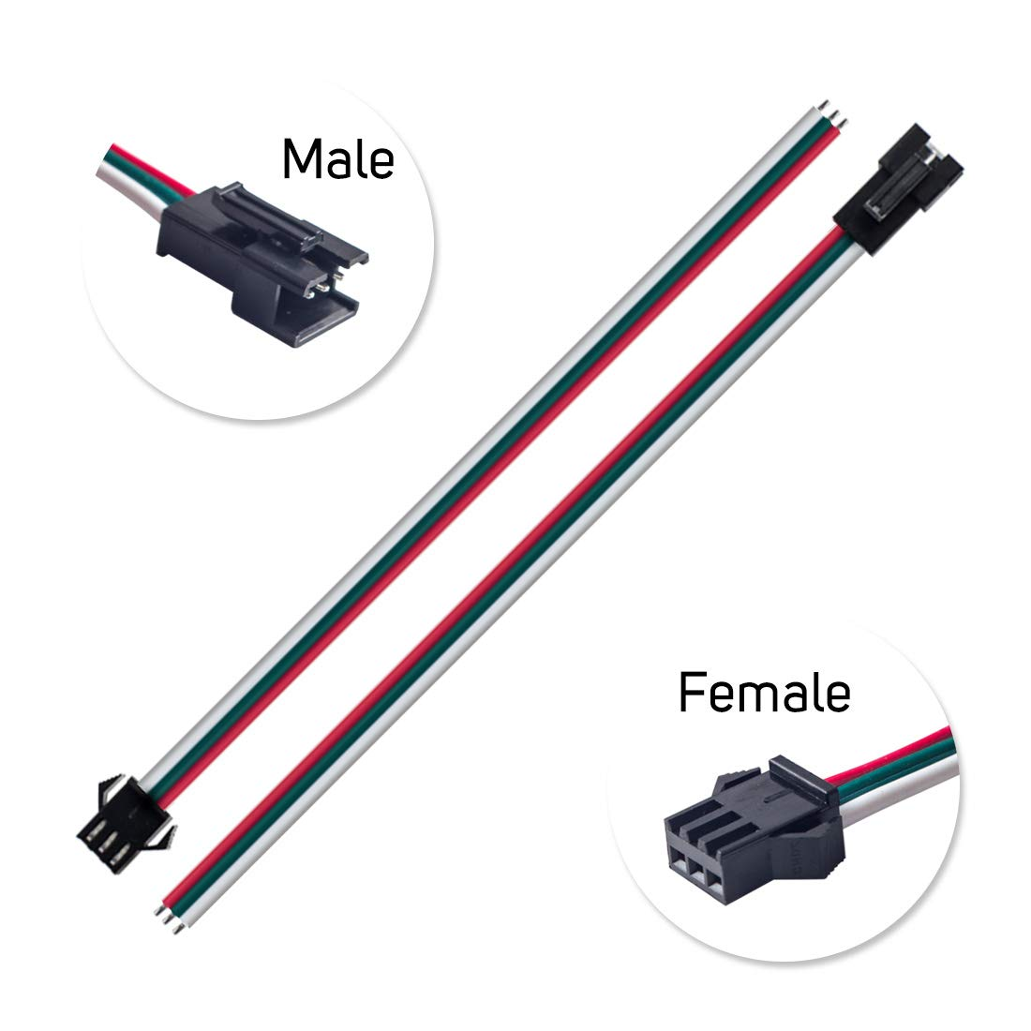
JST SM 3 Pin Pigtail Connectors
The LED Matrix comes presoldered with some of these on, so you might as well use a matching pair so you can quickly connect/disconnect your circuit

Slide 34
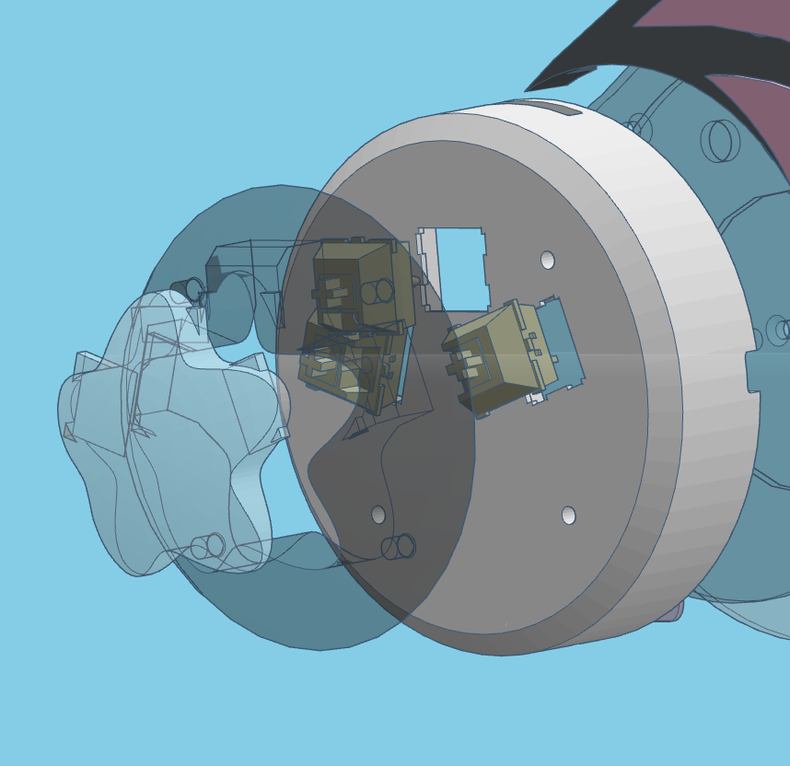
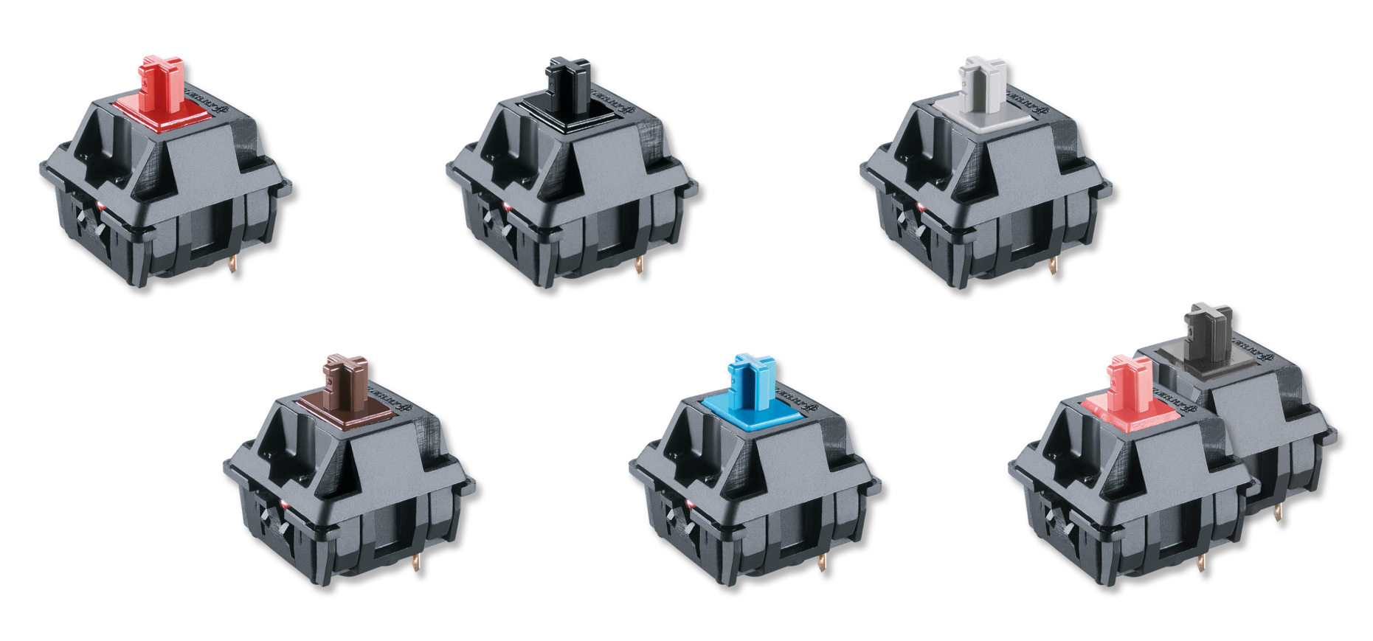
Optional: Cherry MX Switches (x3)
Used to call up preset expressions without having to take out your phone
Doesn’t matter which style
But I like MX Blues for the click

Slide 35
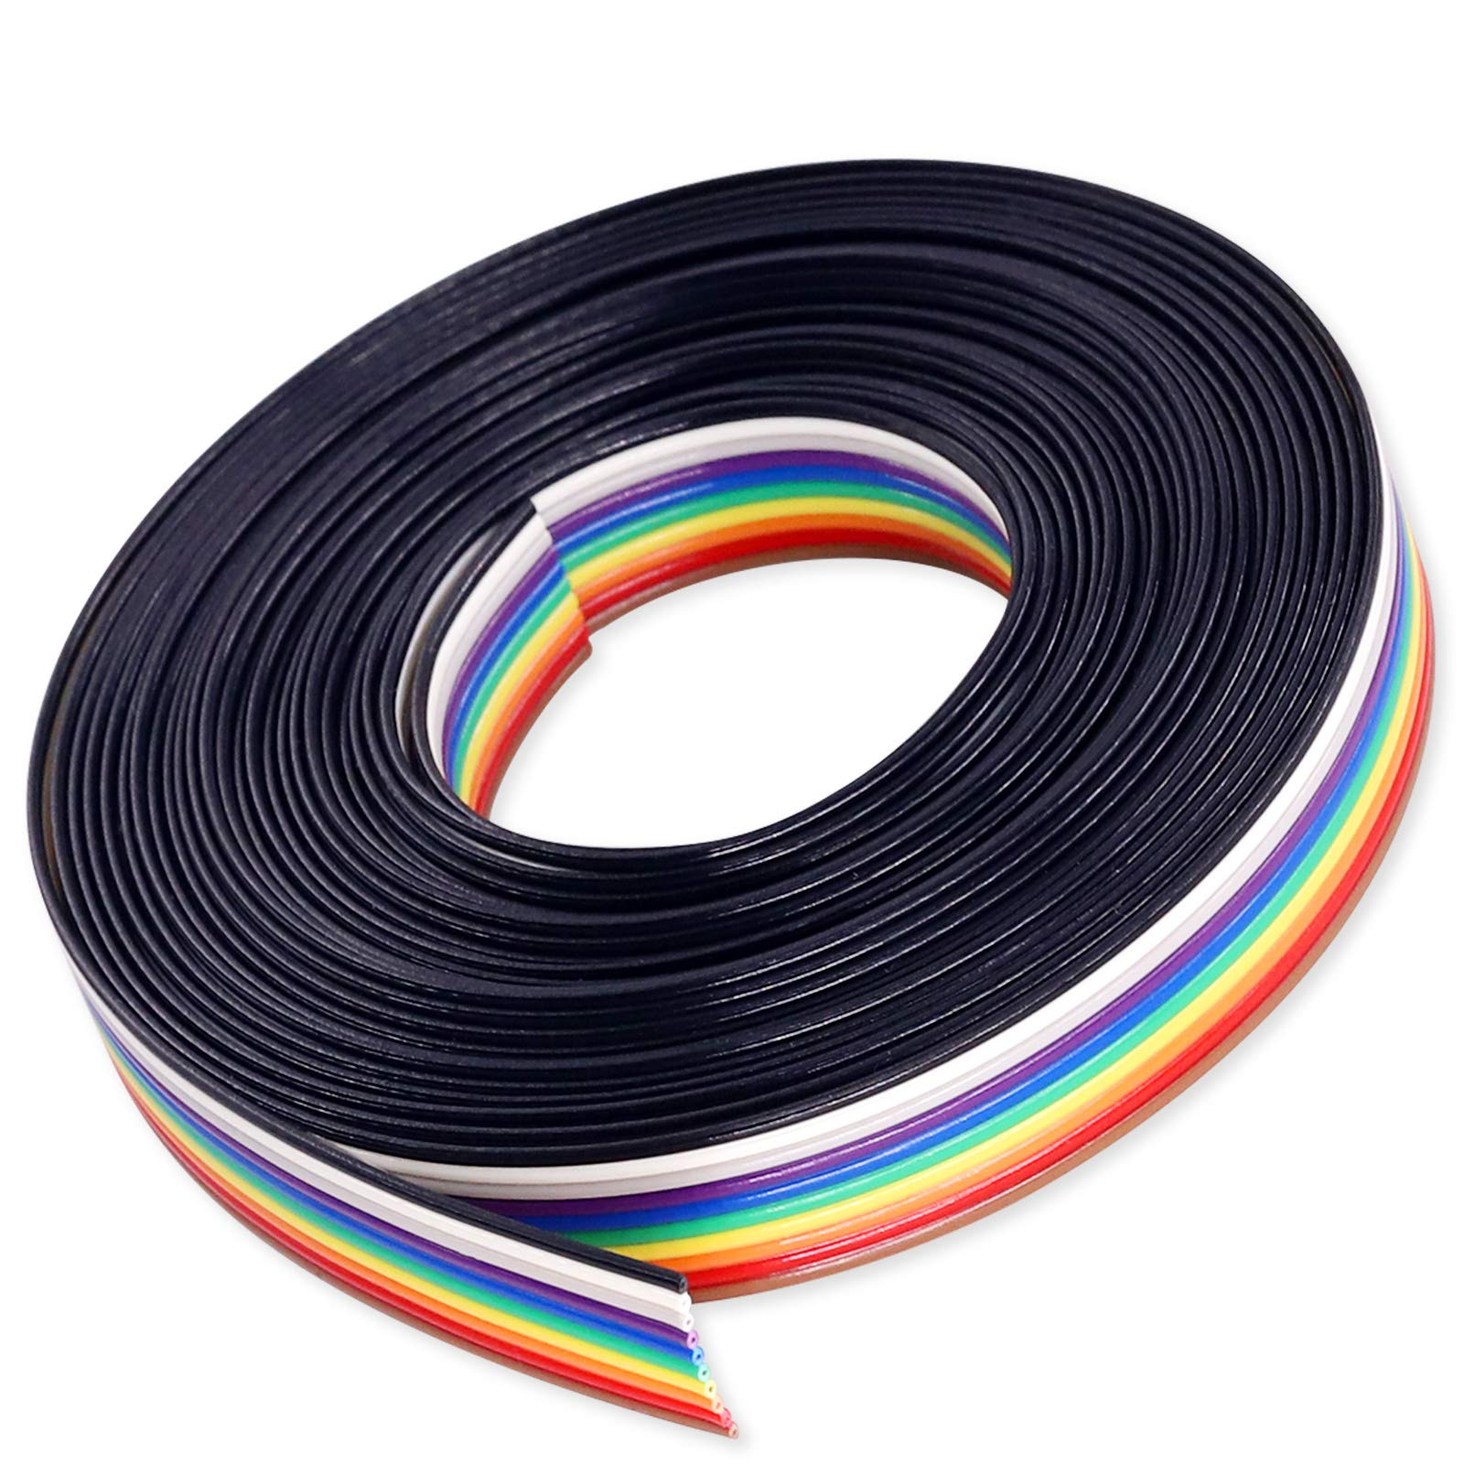
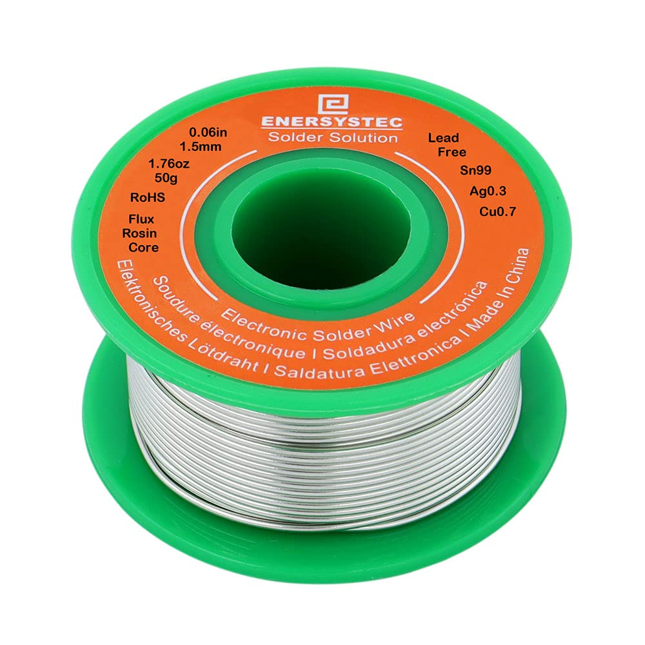
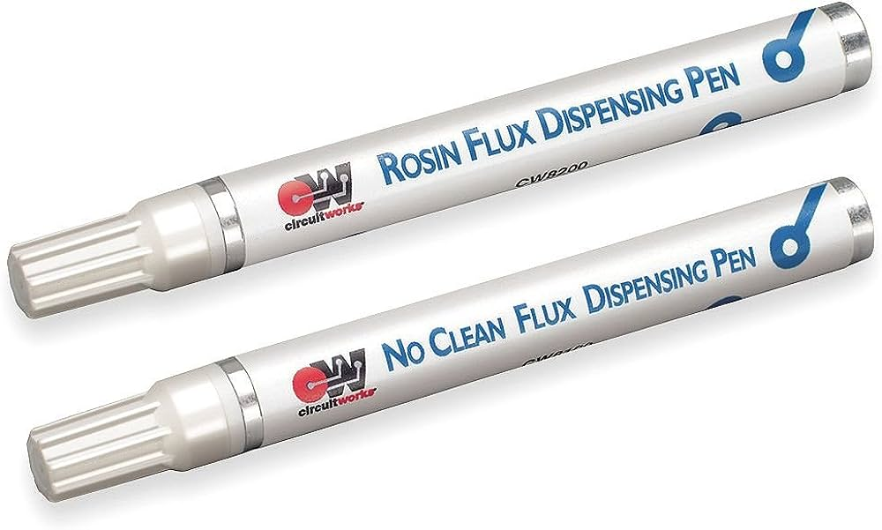
Wires, Solder, Flux, Etc.
It’s an electronics project after all

Slide 36
Materials: Other

Slide 37
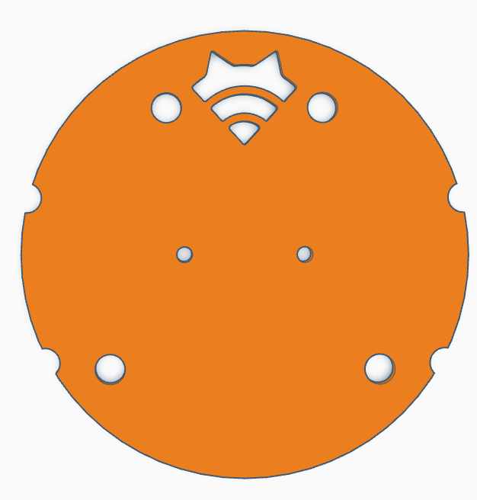
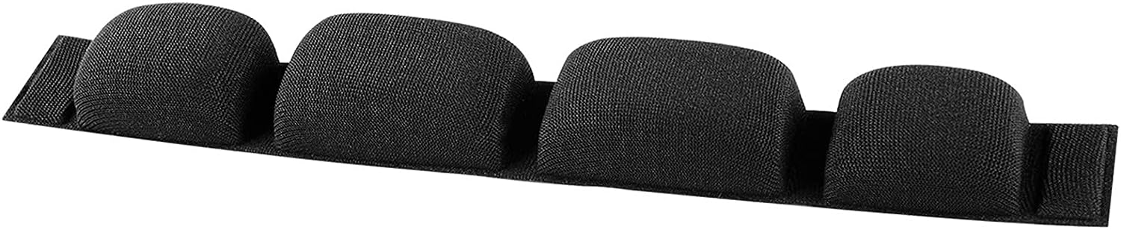
Padding
Ear Pads
I used 100mm circular pads, but it should be pretty easy to modify the foam holder for other sizes (cutouts to access screws underneath)
Optional: Headband Foam
For comfort, attach with Velcro tape or something

Slide 38
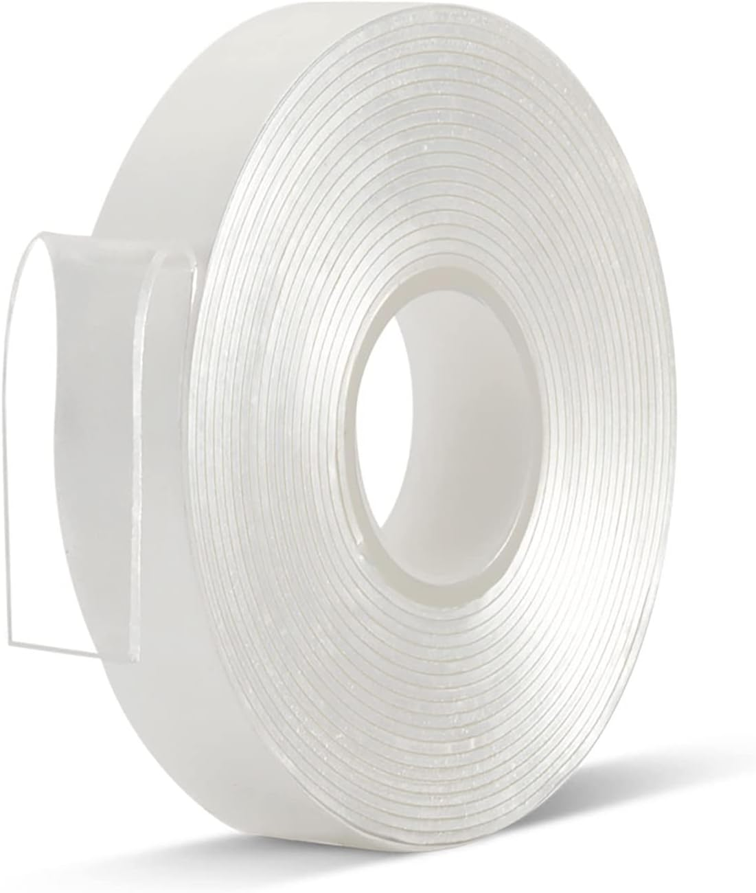
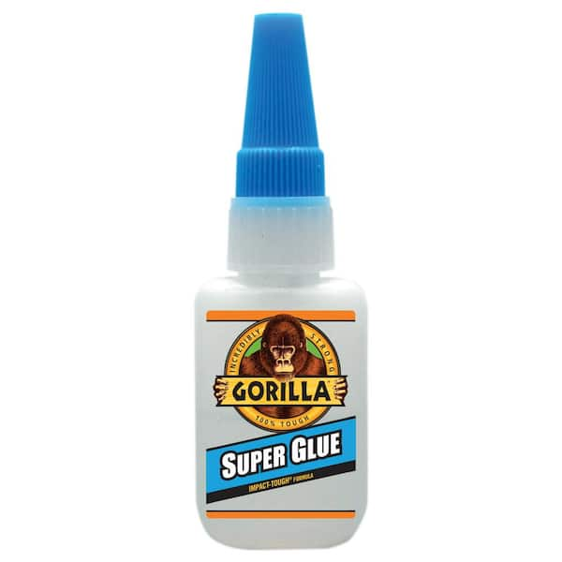
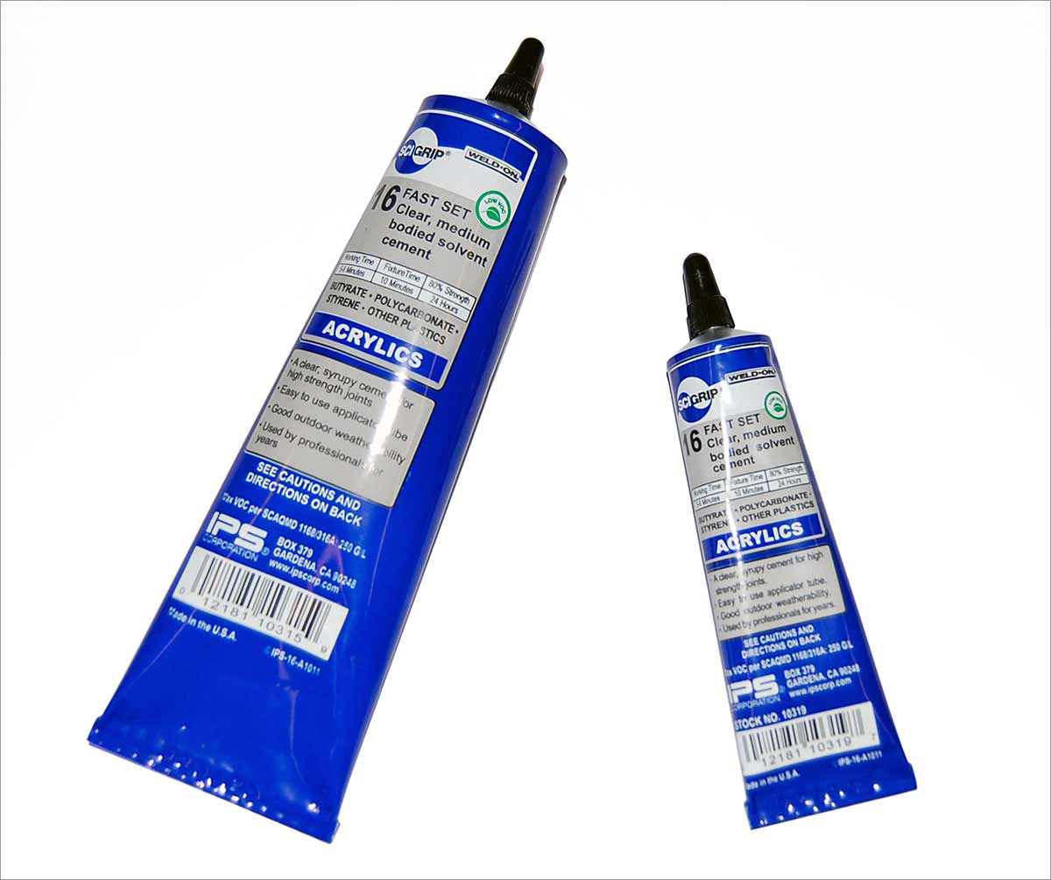
Glue and Tape
Hot Glue for wire strain
Super Glue or SciGrip 16 for repairing parts
Double-sided tape for securing battery and accent pieces

Slide 39
Method Part 1: Flashing the LOLIN C3 Mini

Slide 40
FLASHING THE LOLIN C3 MINI http://blockwonkel.github.io/Rina
Click the big blue CONNECT button. A list of available serial ports will appear.
Plug your LOLIN C3 Mini into your computer. A new port will appear on the list. Note it down.
Activate Device Firmware Upgrade (DFU) Mode on your C3 Mini.
Hold down the “9” Button.
Without letting go of the “9” Button, tap the “RST” Button.
You should hear the USB disconnect sound.
Keep holding down the “9” Button until you hear the USB reconnect sound.
Let go of the “9” Button.
Select the port you previously noted and follow the installation process.
Once you see “Installation complete!”, reset your C3 Mini by pressing the RST button or replugging it. The C3 Mini will now be visible as the Bluetooth Low-Energy (BLE) device “Rina-Chan Board”. The LED matrix (if connected) will now randomly display expressions and respond to the RemoteXY app.

Slide 41
Method Part 2: 3D Printing

Slide 42
3D Printing
As discussed earlier, print the headband and ear cups in PETG (or ABS), along with whatever other parts you can that you think might need the extra durability.
0.4mm or 0.6mm nozzle
Ear cups need supports, rest of the parts should be fine
(Please use a standard printer like an Ender 3. Timelapses just look cooler on belt printers with zero effort)

Slide 43
Method Part 3: Assembly

Slide 44
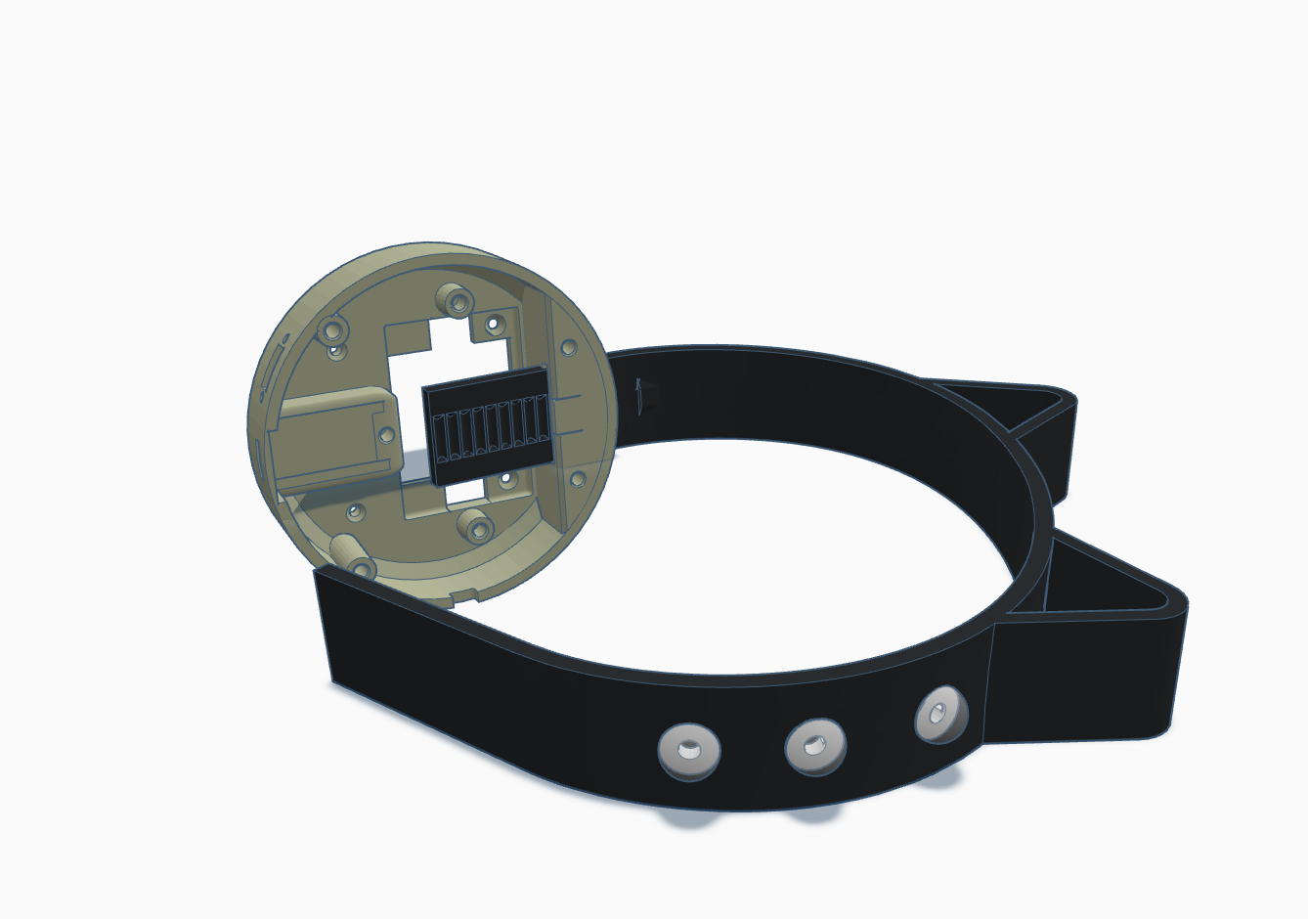
Before you Start Assembly... Check the fit!
Insert the headband into the ear cups.
The ear cup tabs should click onto the notches of the headband, allowing for an adjustable fit.
If fit is too loose, remove ear cup, soften the tab with a heat gun, and press it in to tighten the fit (wear gloves or use a tool since the plastic is hot)

Slide 45
Heat-Set Threaded Insert Locations

Slide 46
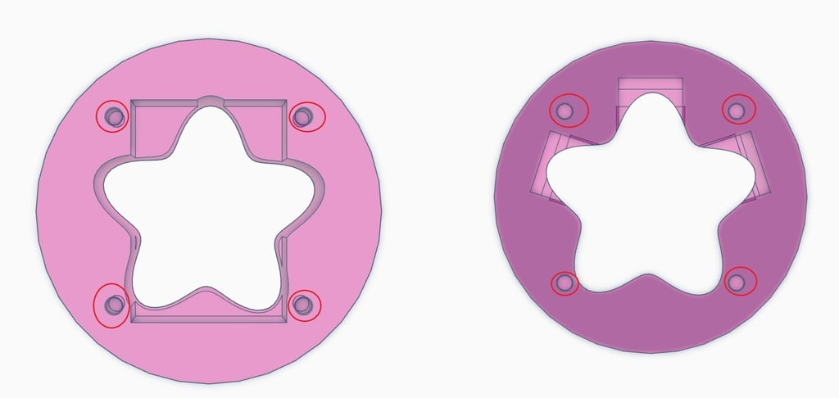
Heat-Set Threaded Inserts (M3x8)

Slide 47
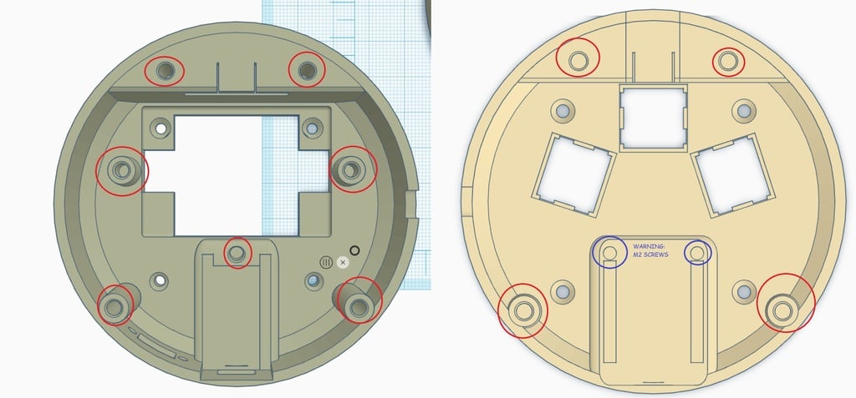
Heat-Set Threaded Inserts (M3x11 and M2x2)

Slide 48
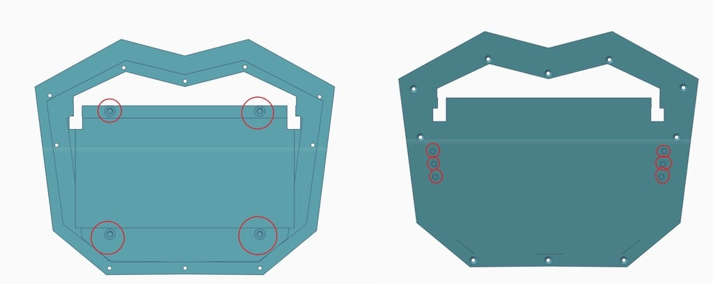
Heat-Set Threaded Inserts (M3x10)

Slide 49
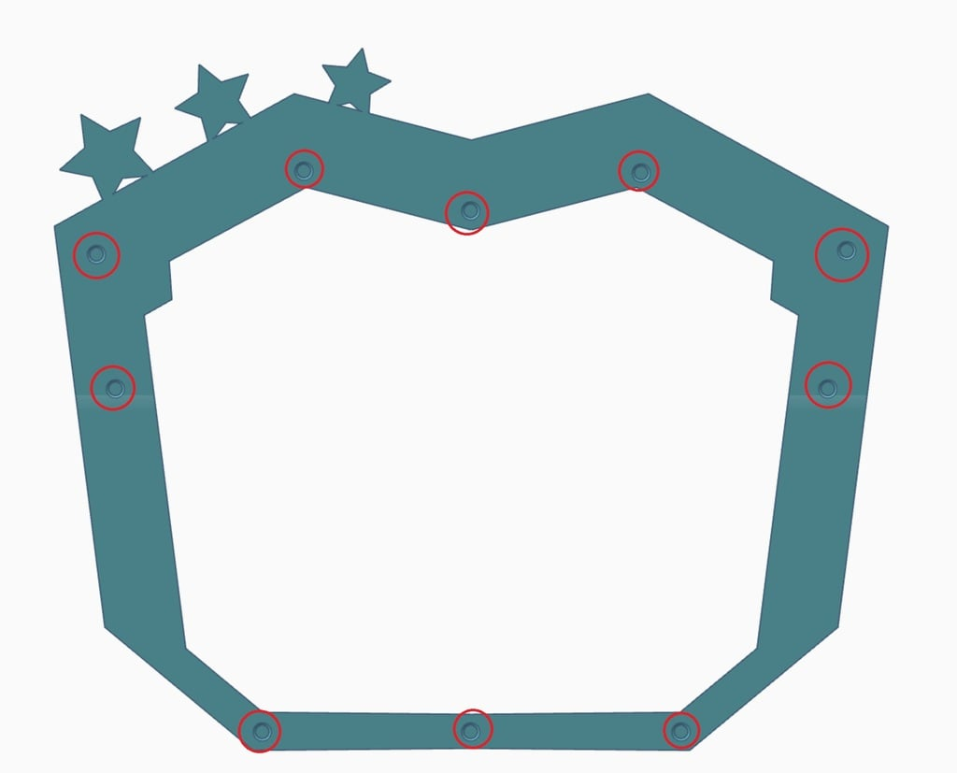
Heat-Set Threaded Inserts (M3x10)

Slide 50
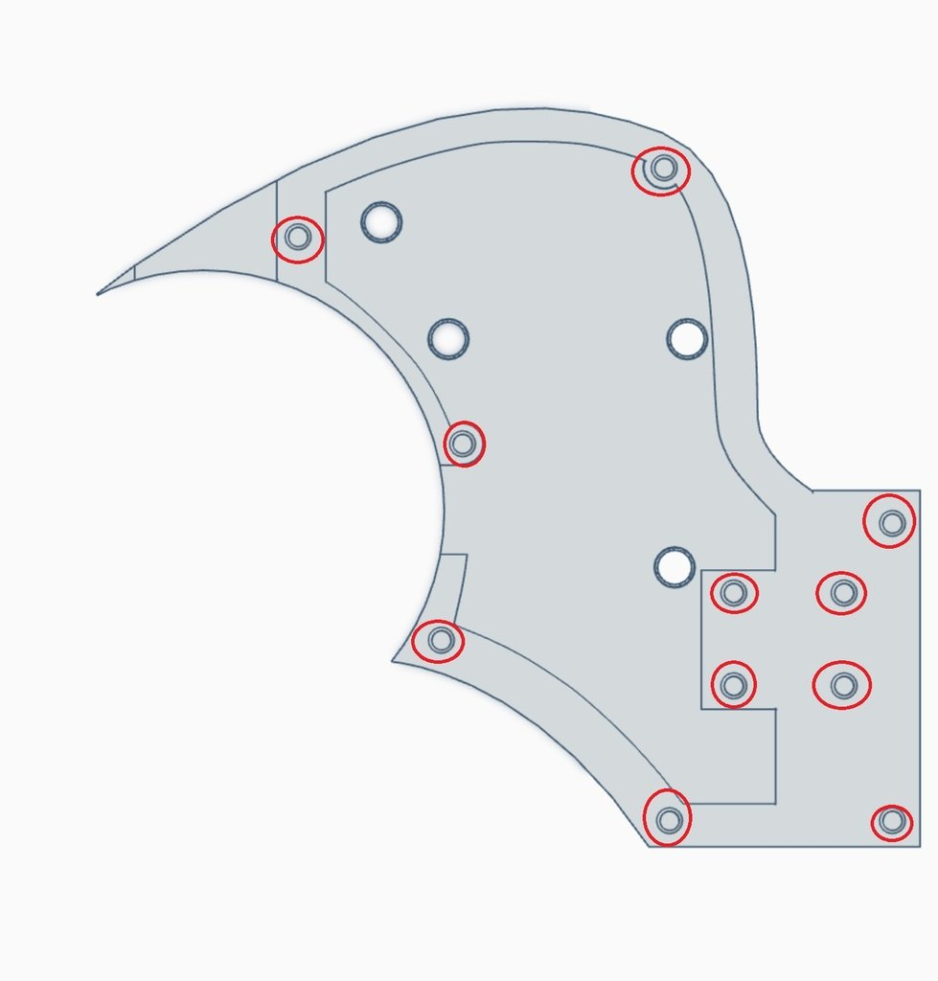

Heat-Set Threaded Inserts (M3x22)

Slide 51

Heat-Set Threaded Inserts (M3x4)

Slide 52
Left Ear Cup Assembly

Slide 53


Glue the Flower into the Dome

Slide 54

Solder Batterie(s) to the TP4056
Solder the red wire to the B+ terminal
Solder the black wire to the B- terminal
Optional: repeat if you want a second battery
WARNING: Make sure the batteries are the same voltage before connecting them!!!

Slide 55



Position Battery between Left Dome and Left Cup
Keep TP4056 inside the Left Cup
Fit the battery through Left Cup’s central hole
Orient battery in portrait orientation
Orient Left Dome so that the hole for the battery is also in portrait orientation and the screw holes line up

Slide 56



Screws (M3x6mm) x4
Screw Left Dome to Left Cup, sandwiching the battery between in the hole made for it

Slide 57





(If using two batteries) Screws (M3x6mm) x2
Secure second battery with tape and/or PCB clips and M3 screws

Slide 58



Prepare the Male Pigtail
Cut or remove the Data wire (green/middle). You can reuse it in a later step (wiring the switch).

Slide 59




Prepare to solder the Switch
Fish the positive wire (red) from the pigtail through the switch hole, with the connector side inside the cup
Fish another wire (such as the green wire removed earlier) through the hole as well

Slide 60

Solder the switch
Solder the positive pigtail wire (red) to the center pin of the switch.
Solder the extra wire (green) to the pin that will be closer to the USB charging port when the switch is mounted.
(Reversing the pins will just change which position is ON and OFF. As long as one of the wires is the middle pin, you’re good)

Slide 61



Solder the TP4056
Solder the extra (green) wire from the Switch to OUT+
Solder the ground (white) wire from the Pigtail to OUT-

Slide 62
Screws (M2x8mm) x2 NUTS (M2) x2
Insert the switch into the hole
Secure with two M2x8mm screws and two M2 nuts
(I know it’s hard to keep the tiny nuts in place on the inside. If it’s easier, you can put the nuts on the outside. Or use glue.)

Slide 63

Screw (M3x6mm) x1
Secure TP4056 with PCB clip and M3 screw

Slide 64
Left Ear Cup Assembly Complete!

Slide 65
Optional: Preset Button Assembly
Requires soldering to Cherry MX Switches
Can Be skipped if you just want random mode + App control

Slide 66

OPTIONAL Cherry MX Switches x3
Insert any 3 Cherry MX-style keyboard switches into the holes...
...with indents oriented to the center.

Slide 67





OPTIONAL: Soldering preset buttons to Ground
Solder a wire to the outer pin on each switch.
Solder that wire to pin 0.
(Pin 0 will be used as an extra Ground)
(You may want to use a bare wire to solder directly to the three pins and then solder a regular wire from that wire to Pin 0)

Slide 68





OPTIONAL: Soldering preset buttons to Input Pins
Solder LEFT switch’s other pin to Pin 1
Solder UP switch’s other pin to Pin 2
Solder RIGHT switch’s other pin to Pin 3
Remember that you’re looking from the bottom.
Getting LEFT and RIGHT flipped isn’t a big deal as they function the same (hold button for a preset expression) but the labels on the app will be reversed.

Slide 69
Right Ear Cup Assembly

Slide 70

Soldering Female Pigtail
Solder POSITIVE to VBUS
Solder DATA to Pin 6
Solder GND to GND
Note the order of the wires. They cross.

Slide 71


DO NOT GLUE!!!
Insert Right Flower into Right Dome, making sure to align the tabs correctly.
The flower will act like a D-PAD.
DO NOT GLUE unless you are omitting the preset buttons.

Slide 72

Position Right Dome Around Cherry MX Switches
Orient the squared leg holes of the flower shape to align with the Cherry MX switches

Slide 73

Screws (M3x6mm) x4
Screw Right Dome to Right Cup

Slide 74
Screws (M2x6mm) x2
Secure the C3 Mini

Slide 75
Hinge Assembly

Slide 76

Screws (M3x30mm) x2 NUTS (M3) x2
Align the shaft holes of both halves.
Insert the hex nut in the hex hole
Insert the screw in the circular hole
Screw it
(To make sure you’re using the correct hinge, ensure the nut is on bottom. Not entirely vital, but if the nut’s on the bottom and it falls out, gravity will keep the screw in and the hinge stays somewhat together. If the screw’s on the bottom and it falls out, the hinge could fall apart.)

Slide 77
Left Side Assembly (Mirror for Right Side)

Slide 78


Screws (M3x6mm) x2
① Align Foam Holder Disk with Inner Side, ensuring orientation of screw holes on the Inner Side matches the orientation of the screws.
Secure with 2 screws.

Slide 79

Screws (M3x8mm) x4
② Align assembled Ear Cup with Inner Side as assembled in ①,
fishing pigtail plug through rectangular hole.
Secure with 4 screws.

Slide 80

Screws (M3x8mm) x7
③ Align Outer Side with Inner Side as assembled in ②
Secure with 7 screws.

Slide 81

Screws (M3x8mm) x4
④ Align corresponding Hinge (screw on top, nut on bottom) onto Side as assembled in ③.
Secure with 4 screws.

Slide 82

Snap-in (or Tape)
⑤ Align Accent Pieces and side spheres with the holes on the Side as assembled in ④.
Snap in place (or, if the parts snap *out* of place, secure with double-sided tape)

Slide 83
Front Assembly

Slide 84

Screws (M3x6mm) x4
① Sandwich the LED Matrix between the Front Back and the LED Matrix Frame.
Secure with four screws.

Slide 85

Screws (M3x8mm) x10
② Sandwich the Face Plate between the Front Front and the Front Back as assembled in ①.
Secure with 10 screws.

Slide 86
Headband
Insert the headphone dots into the headband if using a dotted version.
These might be more trouble than they're worth. A lot of illustrations (and the anime in general) leave this detail off.
Option of dots or no dots
Option of cat ears or no ears

Slide 87
Final Assembly
(The steps you'll repeat and reverse when traveling to cons)

Slide 88
Attach the Sides to the Front

Slide 89

Option 1: M3 Thumb Screws (x2)

Slide 90
Option 2: M3x10mm (x2-6)

Slide 91
Attach the Headband to the Sides

Slide 92
Insert the headband into the Ear Cups
Insert the ends of the headband into the top holes of the ear cups.
The ear cup tabs should click onto the notches of the headband, allowing for an adjustable fit.

Slide 93
And... You're DOne!

